Slide 1

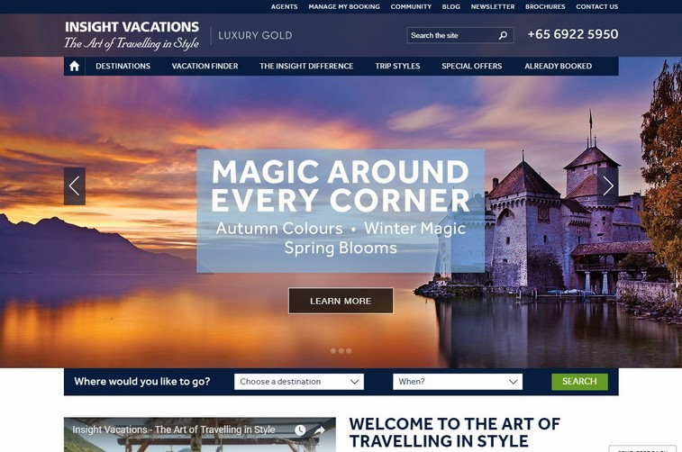
Full Stack Project Presentation
EnVoyageant
Made By: Submitted To:
Nidhi Jain-A Pankaj Kapoor
Radhika Bansal-A
Sakshi Bhardwaj-A

Slide 2

Objective
To build a travelling website which contain all the information about tourist destination and provide the client all the relevant information.
This site will provide users with the right information at the right time and with the enormous facilities.
This site will intent to connect with the audience elegantly.

Slide 3
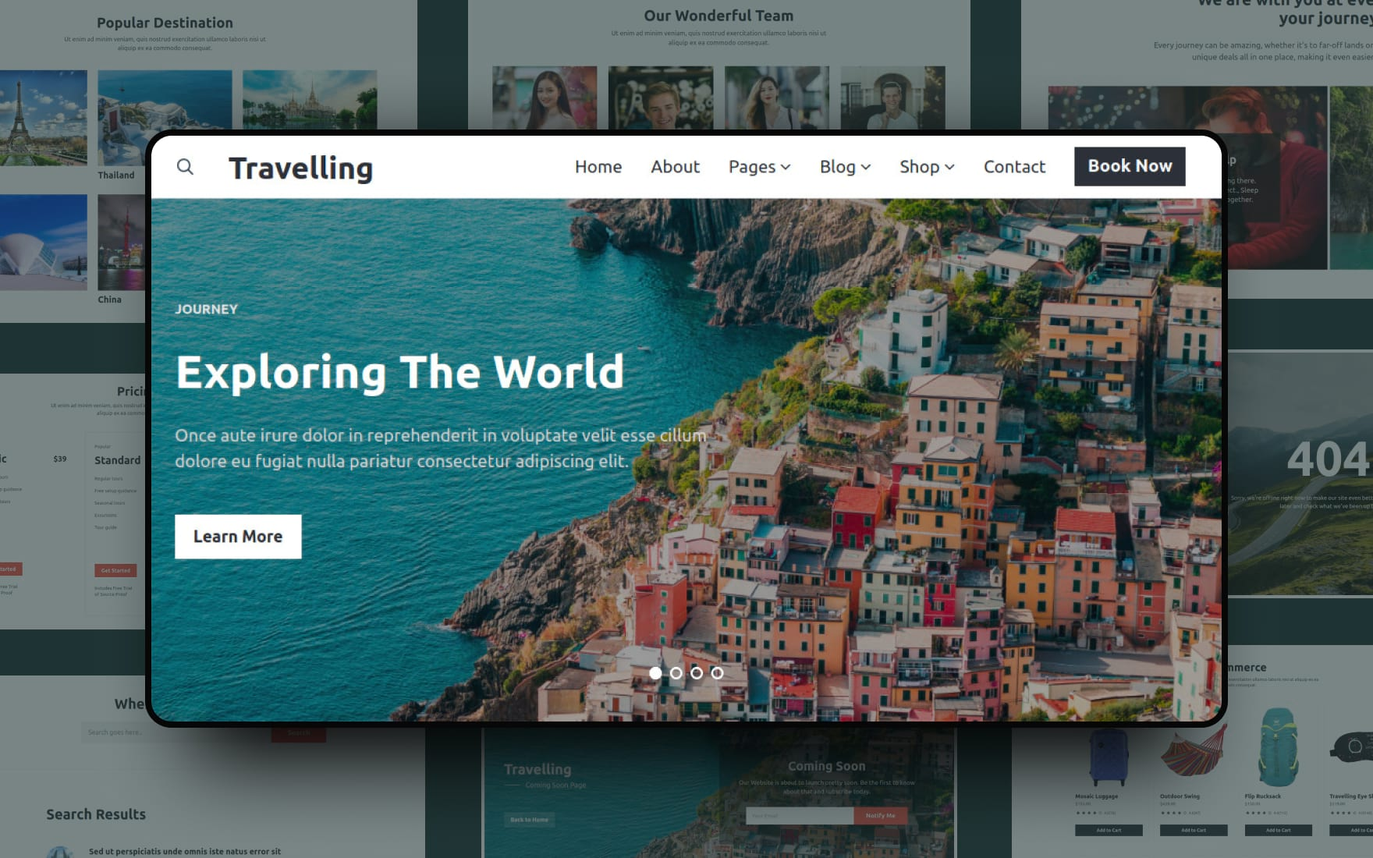
Motivation
when people visit such places they do not have any idea of that place so anyone can mislead them and misguide them.
This prove us to build this website as it will contain all the relevant information about that particular place.
It will help them and also they will get interested to visit and know about such places.

Slide 4
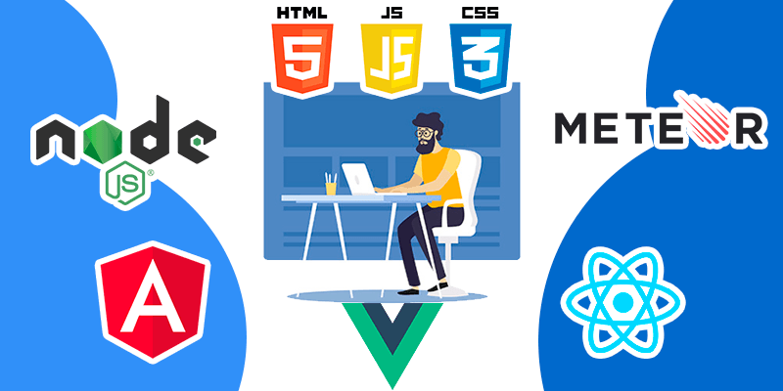
Technology used Web Developing
Html
Cascading Style sheet
JavaScript
JQuery

Slide 5

Html
HTML stands for Hyper Text Markup Language. Hypertext Markup Language is the standard markup language for documents designed to be displayed in a web browser.
It can be assisted by technologies such as Cascading Style Sheets and scripting languages such as JavaScript.
HTML describes the structure of a Web page.

Slide 6
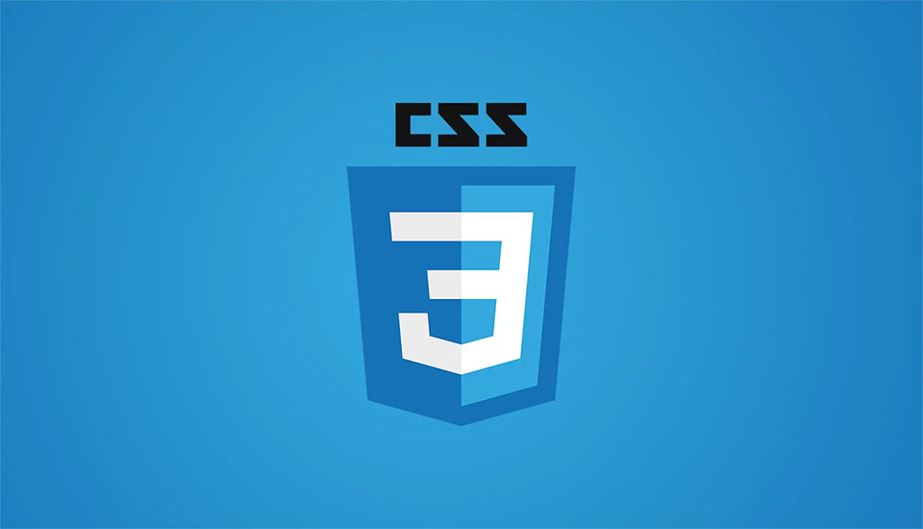
CSS
Cascading Style Sheets is a style sheet language used for describing the presentation of a document written in a markup language such as HTML.
CSS is the language for describing the presentation of Web pages, including colors, layout, and fonts.
CSS is fundamental to web design. Without it, websites would still be plain text on white backgrounds.

Slide 7

JavaScript & JQuery
JavaScript is a language for programming; JQuery is a JavaScript library, a framework that helps you use JavaScript to simplify common web tasks.
jQuery is a lightweight, "write less, do more", JavaScript library.
JavaScript is a text-based programming language used both on the client-side and server-side that allows you to make web pages interactive.

Slide 8
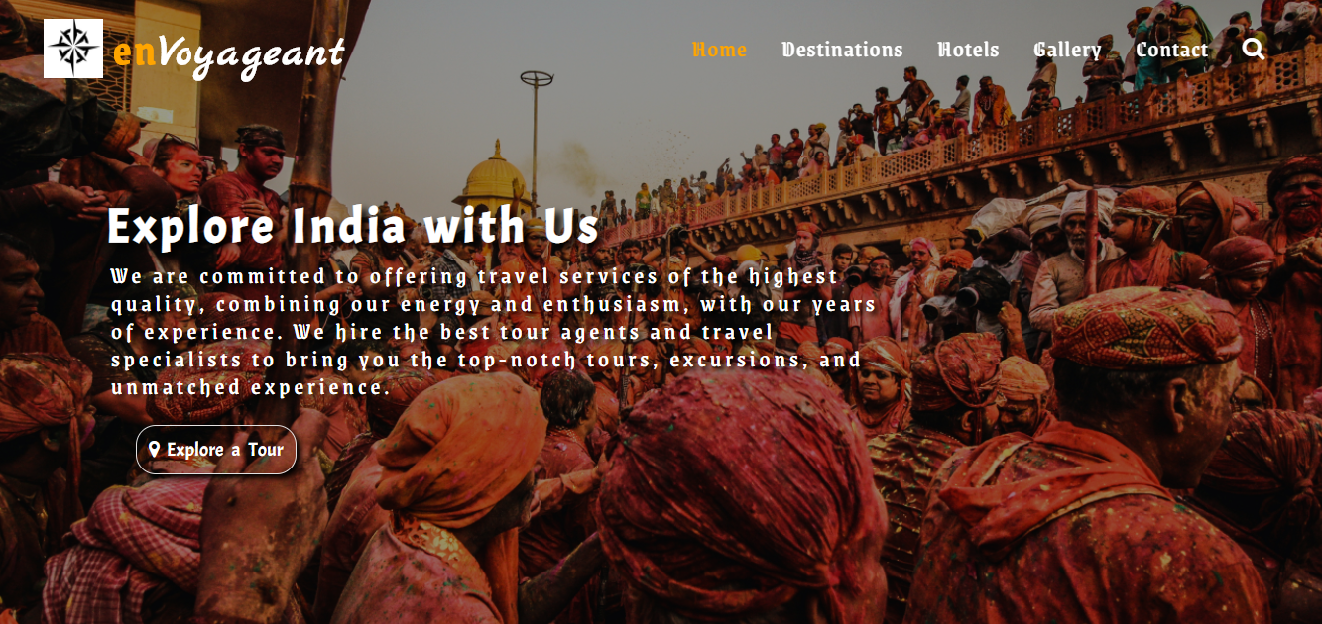
Overview of the website
Our website is multi-page responsive site having five linked pages namely home, destination, hotel, gallery and contact page. It contain all the relevant information needed to the person like hotel booking, destination information and views of various person regarding destinations.

Slide 9
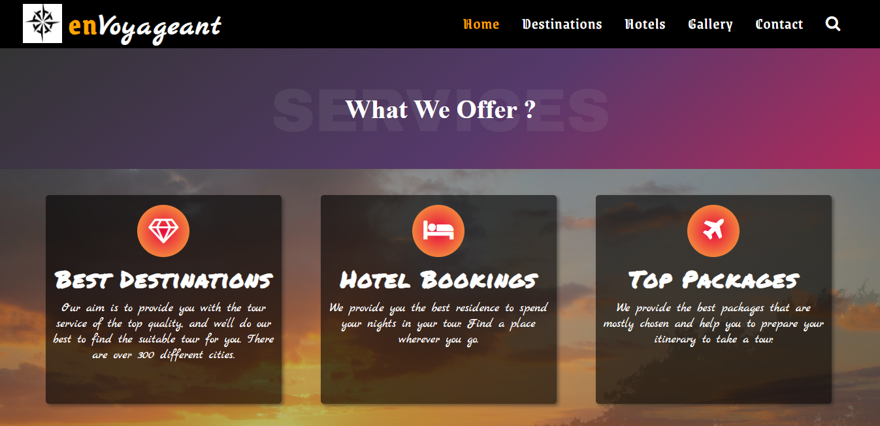
The various facilities provided by our website

Slide 10
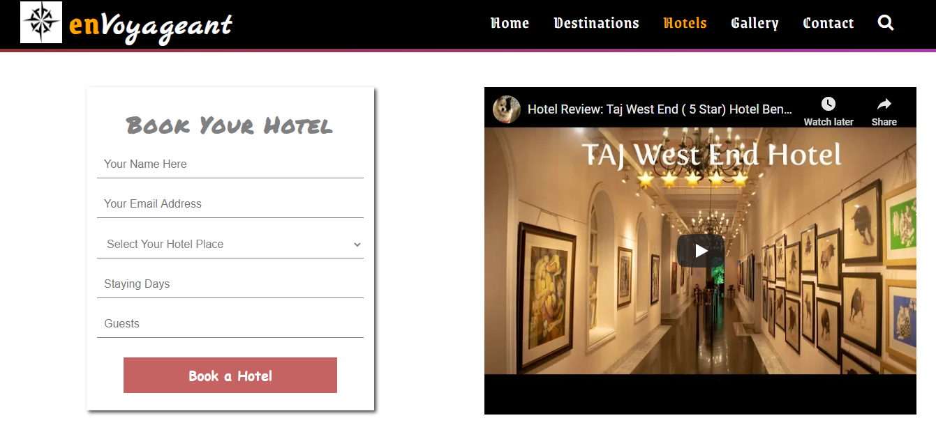
View of hotel webpage

Slide 11
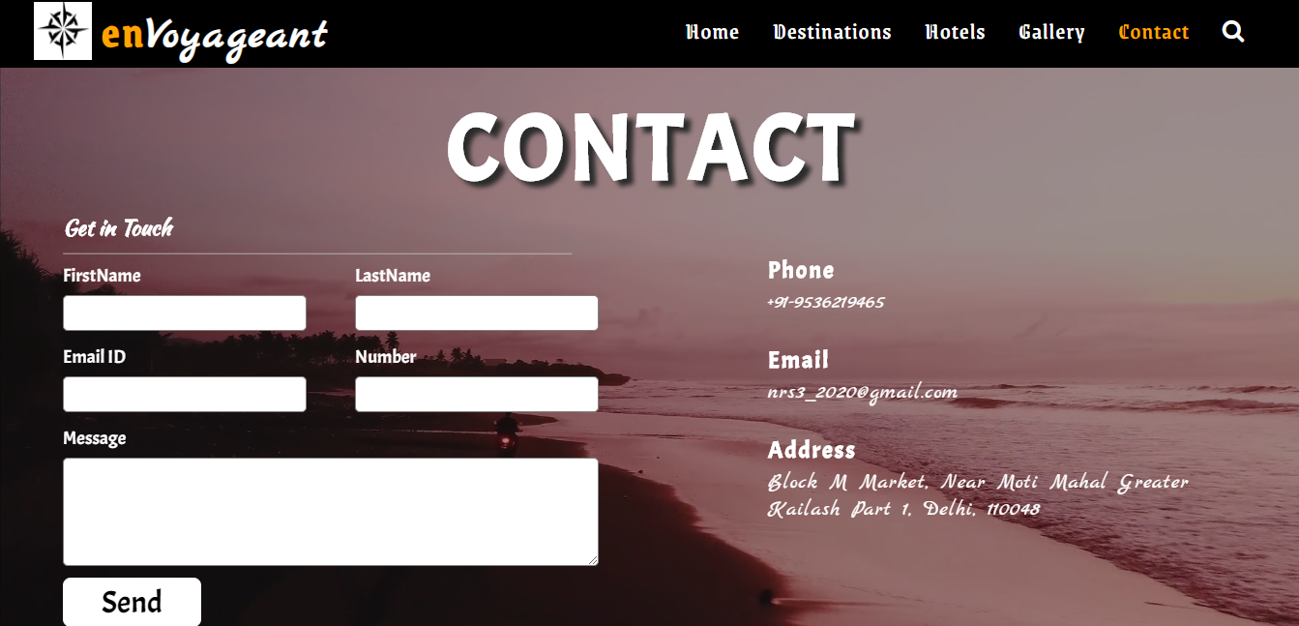
View of contact page

Slide 12


